Slide 1
DEPARTMENT OF ELECTRONIC AND COMMUNICATION ENGINEERING
ECB1222 – TRANSMISSION LINES AND WAVEGUIDES
ACTIVE LEARNING 1

Slide 2
Question
Design and analyze an impedance matching network for a microstrip transmission line using ANSYS HFSS. Consider a 50 Ω microstrip line on a Rogers RT5880 substrate (εr = 2.2, height = 1.6 mm, width = 3 mm) connected to a load impedance of 100 Ω at 5 GHz. The objective is to design an impedance matching network to minimize reflection and maximize power transfer.
(a) Simulate the S-parameters (S11, S21) of the unmatched transmission line and observe the reflection coefficient.
(b) Design a single-section quarter-wave transformer to match the load to the 50 Ω transmission line. Simulate and verify the improvement in impedance matching.
(c) Extend the design to a two-section impedance matching network and compare its performance with the single-section transformer in terms of bandwidth and reflection coefficient.
(d) Analyze how changes in frequency affect the matching efficiency and bandwidth of both designs.

Slide 3
Problem Definition
We need to design an impedance matching network to connect a 50 Ω microstrip line on a Rogers RT5880 substrate to a 100 Ω load at 5 GHz. The matching network should minimize reflection and maximize power transfer

Slide 4
Given Parameters
Substrate: Rogers RT5880
Relative Permittivity (εr) = 2.2
Height (h) = 1.6 mm
Microstrip Width (W) = 3 mm
Operating Frequency (f₀) = 5 GHz
Source Impedance (Z₀) = 50 Ω
Load Impedance (Z_L) = 100 Ω

Slide 5
Simulating the Unmatched Transmission Line
Before designing the matching network, we first simulate the unmatched microstrip line in ANSYS HFSS and observe its S-parameters (S11, S21).
Steps in HFSS Simulation:
Create the Substrate & Microstrip Line
  Define Rogers RT5880 as the substrate.
  Set h = 1.6 mm, W = 3 mm.
  Define a 50 Ω transmission line without matching.
Apply Boundary Conditions
  Use radiation boundaries to simulate an open structure.
  Assign wave ports for signal input and output.
Extract S-parameters
  Simulate S11 (reflection coefficient) and S21 (transmission coefficient).

Slide 6
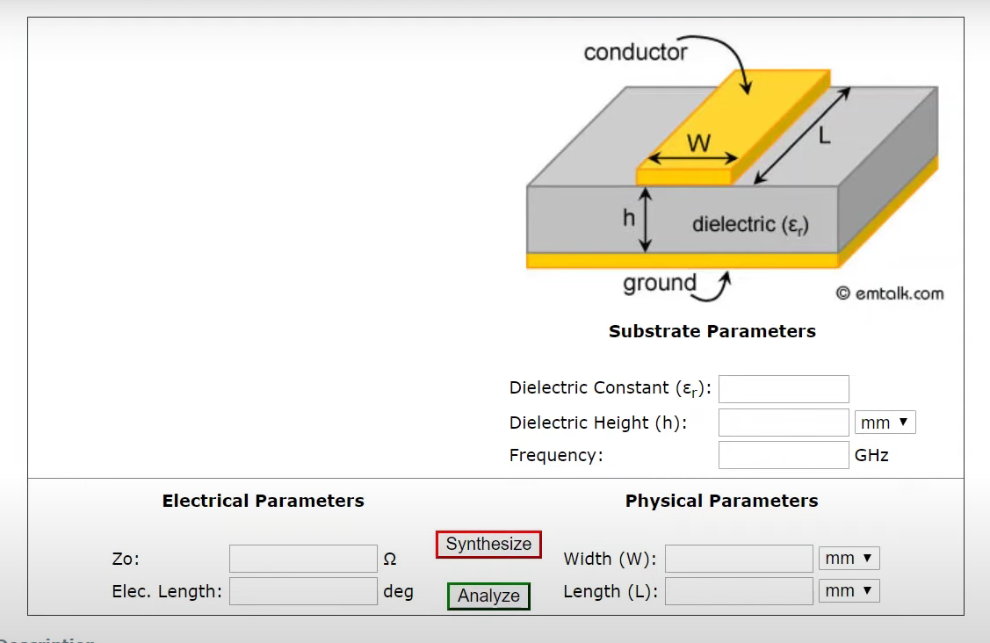

Slide 7
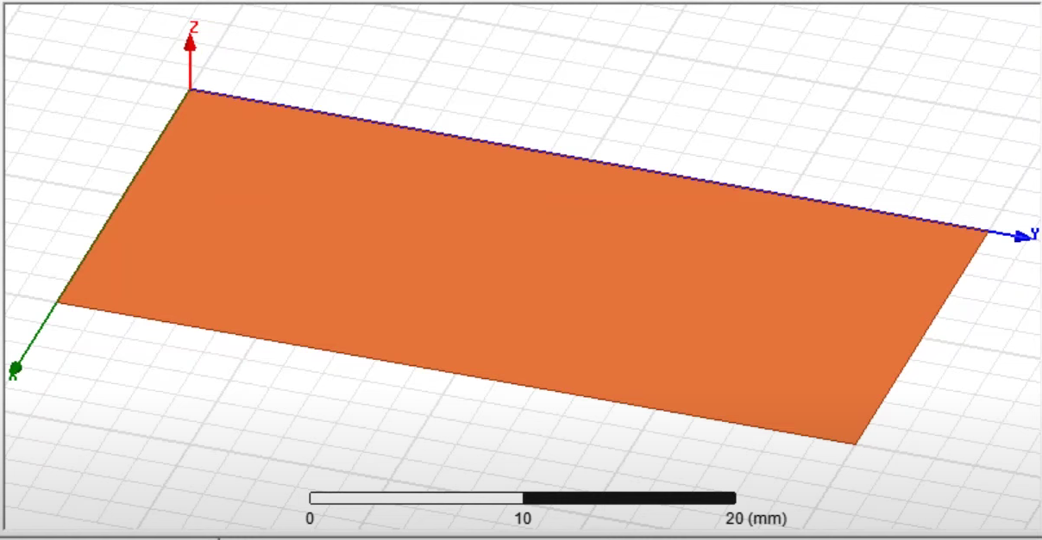

Slide 8
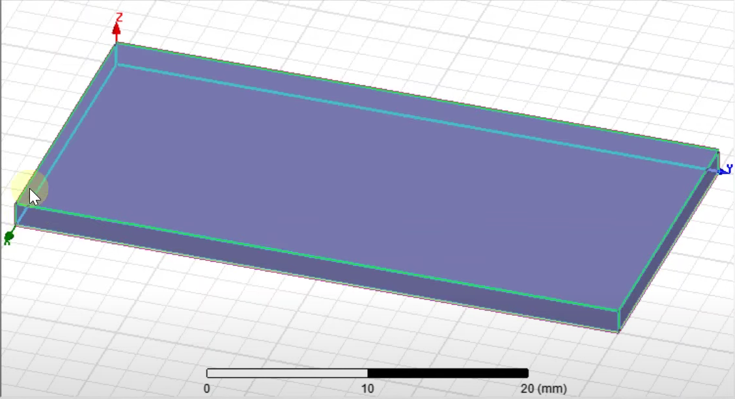

Slide 9
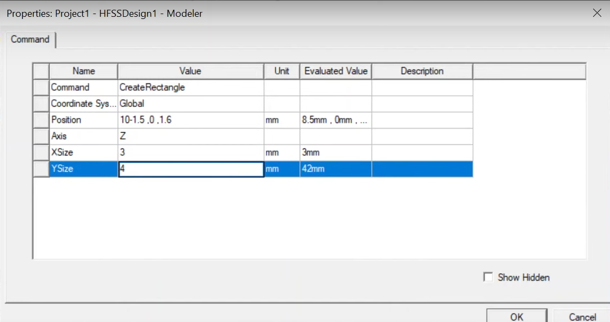

Slide 10
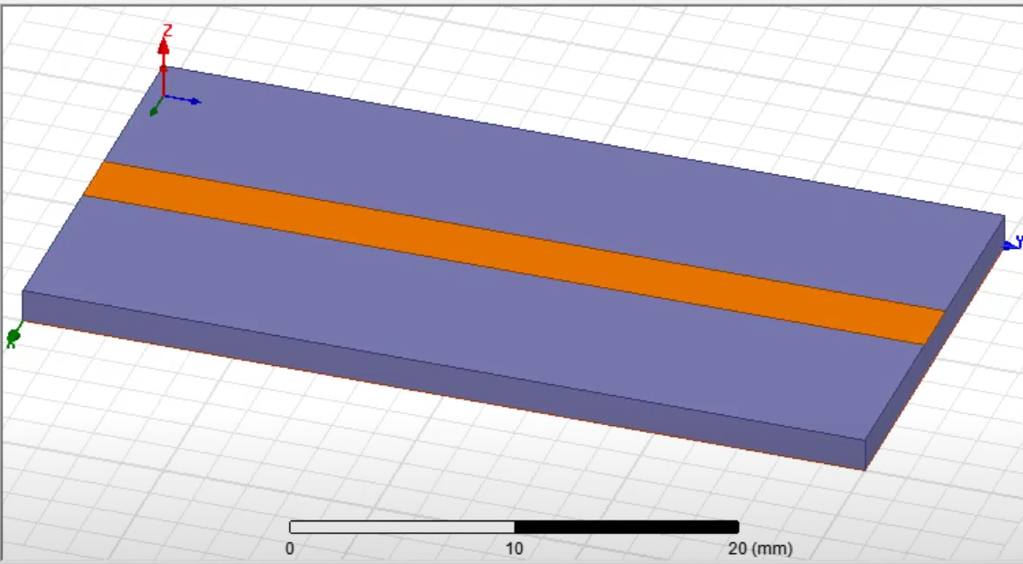

Slide 11
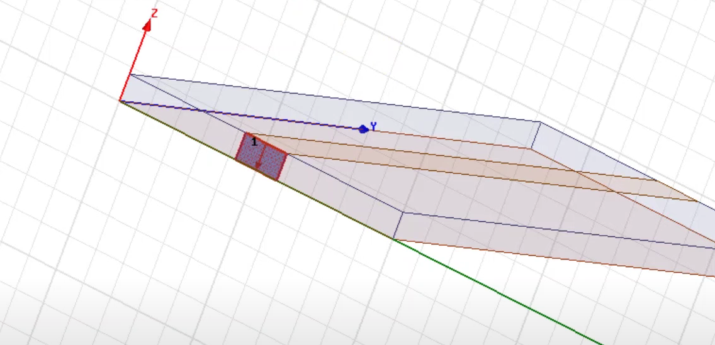

Slide 12
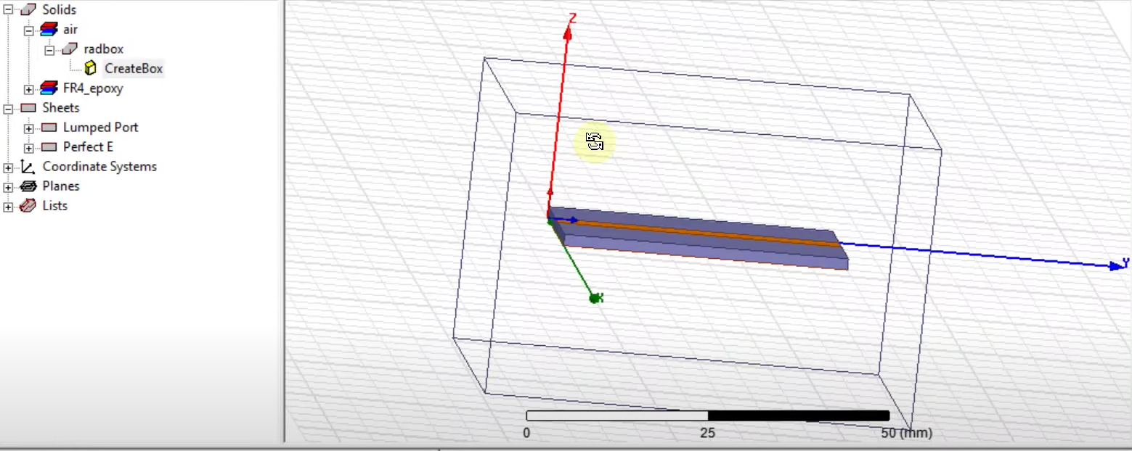

Slide 13
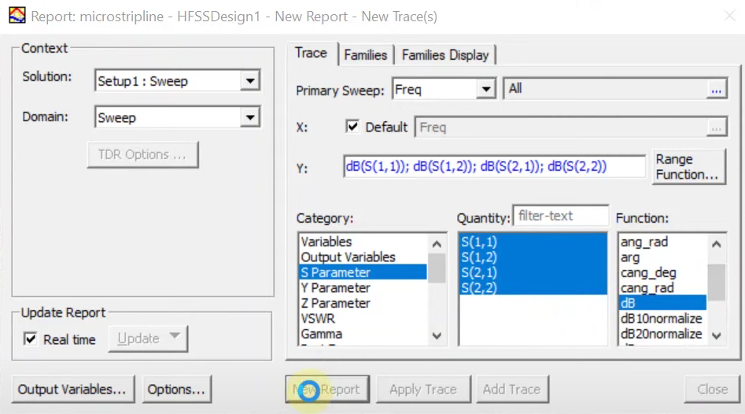

Slide 14
